Slide 1

50.039 Theory and Practice of Deep Learning Course Introduction
Matthieu De Mari

Slide 2

A quick word about instructors
Matthieu (Matt) De Mari
Lecturer at SUTD (Python, Deep Learning, Prog. Language Concepts, Capstone, etc.)
Information Systems Technology and Design (ISTD) and Computer Science and Design (CSD) pillar/faculty
PhD from CentraleSupelec (France)
Email: matthieu_demari@sutd.edu.sg
Office @ SUTD (in SUTD Academy/AI cluster): 2.401-07.

Slide 3
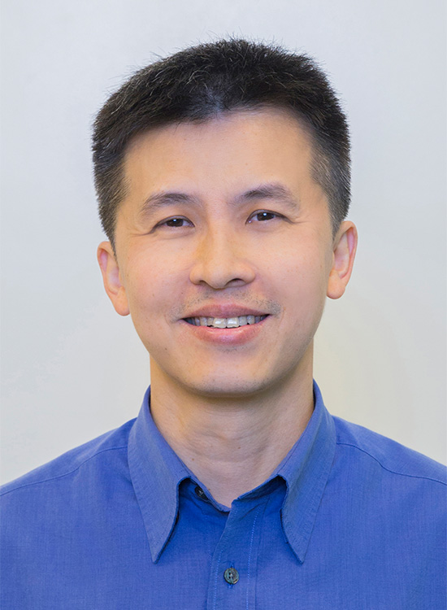
A quick word about instructors
Ngai-Man (Man) Cheung
Assistant Professor at SUTD (Deep Learning, Computer Vision, AI for HealthCare)
Information Systems Technology and Design (ISTD) and Computer Science and Design (CSD) pillar/faculty
PhD from University of Southern California
Email: ngaiman_cheung@sutd.edu.sg
Office @ SUTD (in SUTD Academy/AI cluster): 2.401-26.

Slide 4
A quick word about TAs
Nirmalendu Prakash (TA)
Currently, he is working towards the Ph.D. degree in ISTD at SUTD. His research focus is analysis and mitigation of social biases in language models.
Email: nirmalendu_prakash@mymail.sutd.edu.sg
Telegram: nirmal05
Hazel Hee (TA)
SUTD ISTD Alumni 2022 graduate. Currently working as a Research Assistant. Has TA various subjects for ISTD since 2020.
Email: hazel_hee@sutd.edu.sg
Telegram: hahahazel

Slide 5
Objectives of 50.039 DL
Introduce the technical aspects related to the implementation of Deep Neural Networks from scratch.
Teach the students about the most popular framework for implementing Deep Neural Networks (as of Jan 2023): PyTorch.
Discuss the mathematical foundations and intuitions behind the Deep Learning framework, layers and some techniques.
Give the students a global overview of the advanced techniques related to Deep Learning and Deep Neural Networks.
Describe examples of practical applications of Deep Learning, showing how some key AIs were implemented using Deep Learning.

Slide 6
Objectives of 50.039 DL
Eventually, assemble all concepts and tricks of the trade discussed in this course to produce big architecture models that are close to the current state-of-the-art ones (e.g. ChatGPT, Dall-E, etc.).
Discuss ethical aspects related to some of the concepts discussed.
Give students an understanding of the current state of research in the Deep Learning community, and more specifically pointers as to where the most up-to-date information can be found.
This includes tracking big names in the field, identifying key scientific papers that have changed the field, but also newsletters, websites or magazines that disclose information in Layman terms.

Slide 7
Skills needed for this course
Must-have CS: Python, Numpy, Matplotlib.
Must-have Math: Linear Algebra, multiple variables calculus, derivatives, optimization probability and statistics.
Good-to-have CS: Machine Learning, Data Processing, Scipy, Sklearn.
Good-to-have Math: Graph Theory, Game theory.
Need to revise? No homeworks for the first few weeks…!
Use this time to revise your 10.014 CTD, 10.013 M&A, 10.018 MS&S, 10.022 MU, 10.020 DDW, and 50.007 ML! (Look at bonus slides for details on what to revise…)

Slide 8
The way we teach things
An expert is not someone who
Took a 6h-long online video course,
Implements Neural Networks by randomly connecting basic layers (typically Linear and Conv),
Uses a random framework he/she does not understand (or autoML!),
Cannot obtain more than 80% accuracy on a simple dataset like MNIST or CIFAR-10.
An expert is someone who
Understands how Neural Networks operate and the mathematical intuition behind typical (advanced) operations used in layers,
Understands how the frameworks have been built and what they do behind the scenes,
Knows AI is a fast-evolving field and knows how to stay up to date when it comes to AI.

Slide 9
The way we teach things
One topic per week (or so) and hopefully, we will cover all the important concepts and important directions of DL these days.
Lectures slides, along with supporting notebooks.
Mathematical aspects discussed in class (to show what is happening behind the scenes of Neural Networks/Deep Learning).
Made a choice: providing lots of code to demonstrate concepts, but need you to play with them autonomously to explore concepts!
Extra reading, for curiosity (supporting papers, articles, etc.) and suggestions of pointers to follow to stay up to date.
Suggestions for continuing your learning, after this course.

Slide 10
The way we teach things
I will upload materials on both eDimension and Google Slides (everything referenced on eDimension).
eDimension slides: Read-only, reference slides from Prof.
Video recaps (from COVID years)
New, this year!
Google slides: shared and can be modified/commented by everyone who has link to slides.
Feeling like there is a notion rather obscure? Comment/ask your questions on the Google Slides and other students/Prof can answer!
(Will also greatly help me identify parts/materials that need clarifications/improvements for future generations!)

Slide 11

The way we teach things
I will upload materials on both eDimension and Google Slides (everything referenced on eDimension).
eDimension slides: Read-only, reference slides from Prof, contains ground truth about things (lol).
Google slides: shared and can be modified/commented by everyone who has link to slides.
Feeling like there is a notion rather obscure? Comment/ask your questions on the Google Slides and other students/Prof can answer you!

Slide 12
Syllabus (Detailed syllabus on eDimension)
Week 1: Introduction to course. Some ML jargon reminders, including linear and polynomial regression, generalization, ridge regression and regularization, overfitting/underfitting, logistic regression, neurons objects and how they relate to biology. Building our first shallow neural network in Numpy, gradient descent reminders, training and testing procedure.
Week 2: Introduction to PyTorch framework, tensors and dataloaders. Implementing a shallow neural network in PyTorch, using backpropagation in PyTorch with AutoGrad, advanced optimizers. Multi-label classification with shallow neural networks, moving from shallow to deep neural networks.

Slide 13
Syllabus
Week 3: Guided project and good practices for Deep Learning projects (train/test/dev, bias/variance, advanced regularization, dropout, normalizing inputs/outputs/layers, trainer functions, savers/loader functions for reproducibility and transfer learning). Discussion about the project assessment component.
Week 4: The image data type, image processing techniques and typical computer vision operations, the convolution operation and layers, Convolutional Neural Networks, advanced CNNs and SotA. Preparing transition to the 50.035 Computer Vision course.

Slide 14
Syllabus
Week 5: Continuation of Week 4, and more advanced concepts of Computer Vision. Adversarial machine learning, attacking a Neural Network with basic gradient-based attacks, fundamental limits of Neural Networks, defence mechanisms and state-of-the-art of some advanced attacks techniques.
Week 6: Sequential data (times series, text, etc.), vanilla Recurrent Neural Networks, Gated Recurrent Units, Long-Short Term Memory cells, advanced RNN networks, mixing models for advanced architectures. Recap before MidTerm.

Slide 15
Syllabus
Week 8: The embedding problem, more advanced concepts on RNNs, introduction to Natural Language Processing (NLP) and Word Embeddings for NLP, brief state-of-the-art on NLP, attention and transformers architectures. Preparing transition to the 50.040 Natural Language Processing course. MidTerm exam (based on W1-6). One lecture might move to Week 6.
Week 9: Quick introduction to Graph Theory and typical graph datasets and problems, basics of Graph Convolutional Networks, brief state-of-the-art of advanced Graph Convolutional Networks.

Slide 16
Syllabus
Week 10: Generative Models, Autoencoders and Variational Autoencoders, Generative Adversarial Networks (GANs), Advanced concepts on Generative Adversarial Networks, why is it so difficult to train GANs in practice. Basic introduction to diffusion models (more details to be covered in the 50.035 Computer Vision course). If time allows, practice on GANs.
Week 11: Topics for curiosity. Introduction to Physics-Informed Neural Networks. Introduction to deep belief models and diffusion models. Introduction to Explainability/Interpretability and open questions in research about Neural Networks. What will be the next revolution in AI? (a word on ChatGPT, Dall-E, etc.).

Slide 17
Syllabus
Week 12: Brief introduction to reinforcement learning, and state-action-rewards systems, multi-armed bandit problem and the exploration/exploitation trade-off, Q-learning and Deep Q-Learning. Brief state-of-the-art discussion about further works in Reinforcement Learning.
Week 13: Recap. Closing and future directions for studying Deep Learning. Project presentations and guest conferences (TBA).
Week 14: Final exam (probably on content from W1-13).

Slide 18
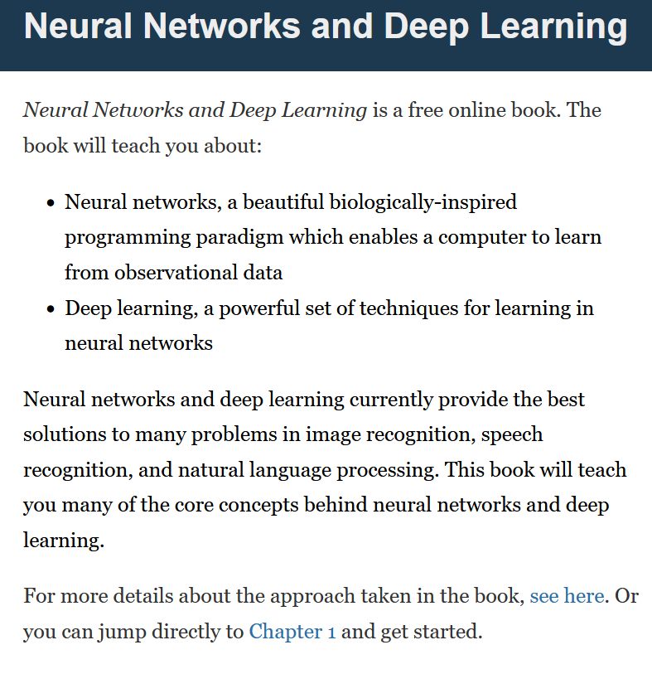
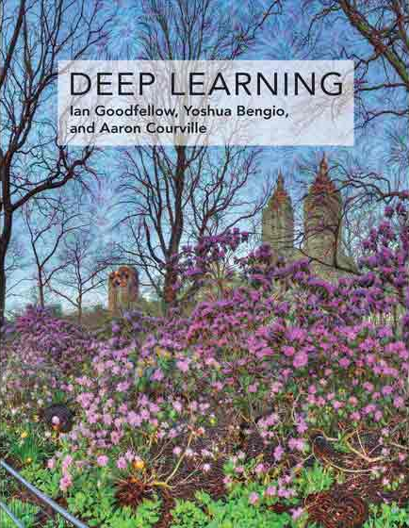

Supporting Textbooks
Supporting textbooks, for your curiosity (not needed to understand this course).
Michael A. Nielsen, “Neural networks and deep learning”, 2015. (http://neuralnetworksanddeeplearning.com/)
Ian Goodfellow, Yoshua Bengio and Aaron Courville, “Deep learning”, 2016. (https://www.deeplearningbook.org/)
Stevens et al., “Deep Learning with PyTorch”, 2020. (https://www.manning.com/books/deep-learning-with-pytorch)

Slide 19
Evaluation and grading
Homeworks (20%): Given on Weeks 3, 5, 8, 10 (tentative) Usually come in the form of a Jupyter Notebook, containing explanations, code snippets and questions. Submissions on eDimension, two weeks later or so, as a small PDF report containing code, figures and answers to questions. When time allows, debrief of homeworks in class.
MidTerm Exam (20%): Given on Week 8, March 13th 2024, 2.30pm. Theoretical, paper exam, notions of Week 1-6 to be tested. More details about venue and exam to be announced closer to the exam date.

Slide 20
Evaluation and grading
Final Exam (25%): Given on Week 14, April 24th 2024, 9am. Theoretical, paper exam, notions of Week 1-13 to be tested. More details about venue and exam to be announced.
Project (31%): Groups of 2-3 students. Submission for project (code, report, presentation) expected on Week 13. More details about the project will be given on Week 3.
Participation (2%): To our discretion.
Student Feedback Survey (2%): As per usual.

Slide 21



Technical pre-requisites
Install Python 3, if you have not done so already (this course does not cover C++/Java).
Libraries needed (maybe more based on projects/homeworks): numpy, matplotlib, scipy, sklearn, networkx, pillow, gym.
Jupyter notebooks for demos of code, along with the slides.
In doubt, you can always use Google Colab to run the codes.

Slide 22

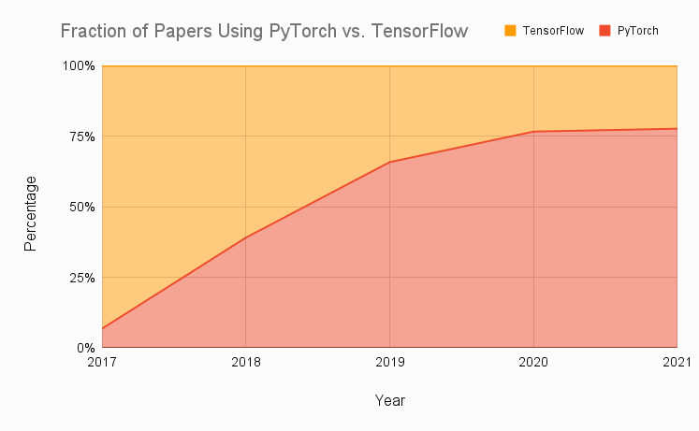
Technical pre-requisites
Framework of choice will be PyTorch! (not Tensorflow, not Keras, not MXNet, etc.)
Increasing popularity and preferred to Google’s Tensorflow these days for many reasons.
Learn more, if curious: https://www.assemblyai.com/blog/pytorch-vs-tensorflow-in-2022/

Slide 23
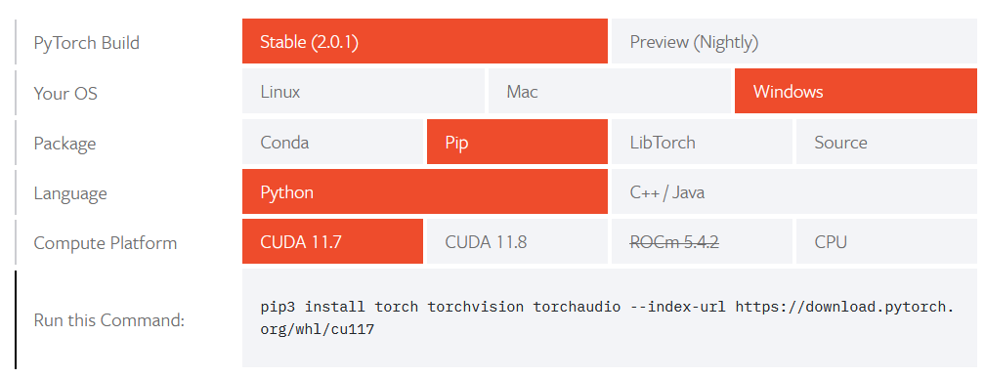
Installing PyTorch and CUDA
Install PyTorch, by getting the right version from https://pytorch.org/get-started/locally/
Setting up CUDA/GPU acceleration is always a good idea! (More details in bonus slides).

Slide 24
50.039 Theory and Practice of Deep Learning W1-S1 Introduction and Machine Learning Reminders
Matthieu De Mari

Slide 25
About this week (Week 1)
What are the typical concepts of Machine Learning to be used as a starting point for this course?
What are the different families of problems in Deep Learning?
What is the typical structure of a Deep Learning problem?
What is linear regression and how to implement it?
What is the gradient descent algorithm and how is it used to train Machine Learning models?
What is polynomial regression and how to implement it?
What is regularization and how to implement it in Ridge regression?

Slide 26
About this week (Week 1)
What is overfitting and why is it bad?
What is underfitting and why is it bad?
What is generalization and how to evaluate it?
What is a train-test split and why is it related to generalization?
What is a sigmoid function? What is a logistic function?
How to perform binary classification using a logistic regressor and how is it related to linear regression?

Slide 27
About this week (Week 1)
What are Neural Networks and how do they relate to the biology of a human brain?
What is a Neuron in a Neural Network and how does it relate to linear/logistic regression?
What is the difference between a shallow and a deep neural network?
How to implement a shallow Neural Network manually and define a forward propagation method for it?
How to train a shallow Neural Network using backpropagation? How to define backward propagation and trainer functions?

Slide 28
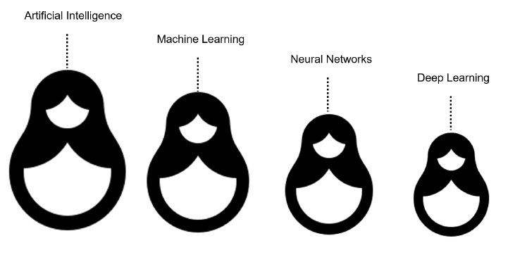
What is AI/ML/NN/DL?
Artificial intelligence
Machine Learning
Neural Networks
Deep Learning
Definition (Artificial Intelligence):
In Computer Science, Artificial Intelligence (AI) refers to the theory and development of computer systems capable to replicate/emulate the human brain, more specifically perform cognitive tasks that normally require human intelligence, such as visual perception, speech recognition, decision-making, and translation between languages.

Slide 29
What is AI/ML/NN/DL?
Conventional programming
Definition (Machine Learning):
In Computer Science, Machine Learning (ML) refers to the field of study that describes techniques and algorithms that give computers the ability to learn without being explicitly programmed.
Some implementations of machine learning may rely on data and neural networks.
Input (Given)
Function
(Created)
Output
(Obtained)
VS.
Machine Learning
Input (Available)
Function
(?)
Output
(Available)

Slide 30
What is AI/ML/NN/DL?
What we have done in programming so far was to design functions,
which would do specific operations,
and return outputs,
for any input we could give it.
But sometimes, we can encounter problems where
we can easily find inputs and expected outputs,
but the function to be coded is not simple to figure out.
E.g., what animal in picture?
Input (Given)
Function
(Created)
Output
(Obtained)
Input (Available)
Function
(?)
Output
(Available)

Slide 31
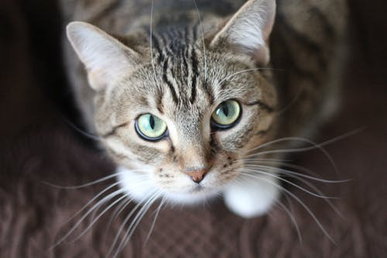
What is AI/ML/NN/DL?
E.g., what animal is in the picture?
Typical problem in Computer Vision, called Image Recognition.
Input x (available)
Function f
(?)
Output y = f(x)
(available)
Very easy for a human…
But, how would we explain the logic of it to a computer?
It’s a cat!

Slide 32
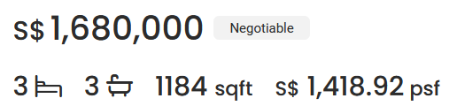
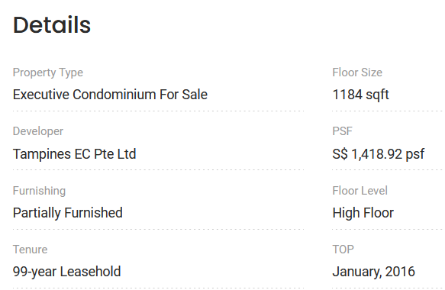

What is AI/ML/NN/DL?
Other scenarios have to do with tasks where there is no easy closed-form expression connecting inputs to outputs.
E.g., what is a good selling price for my appartment?
Guessing the selling price of an appartment based on its parameters (size, location, etc.) and previous sales.

Slide 33

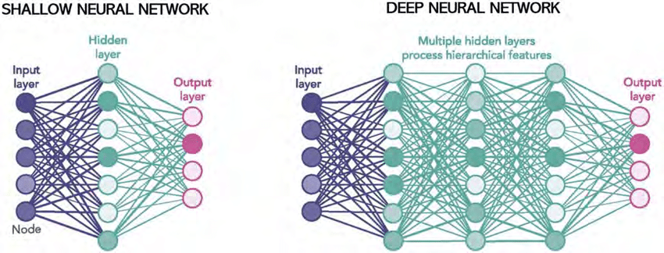
What is AI/ML/NN/DL?
Definition (Neural Networks):
Neural Networks (NNs) are computing systems inspired by the biological neural networks that constitute animal brains.
NNs are based on a collection of connected units (or nodes) called artificial neurons, which are a (loose) model for the neurons in a biological brain.

Slide 34
What is AI/ML/NN/DL?
Definition (Neural Networks):
Neural Networks (NNs) are computing systems inspired by the biological neural networks that constitute animal brains.
NNs are based on a collection of connected units (or nodes) called artificial neurons, which are a (loose) model for the neurons in a biological brain.
Each connection, like the synapses in a biological brain, can transmit a signal to other neurons, therefore processing any information given as inputs and producing a final signal as output.

Slide 35
What is AI/ML/NN/DL?
Definition (Deep Learning):
Deep Learning (DL) is a subfield of machine learning, and deep neural networks make up the backbone of deep learning algorithms.
The number of node layers, or depth, of neural networks is what distinguishes a shallow neural network from a deep neural network, which must have more than three.

Slide 36
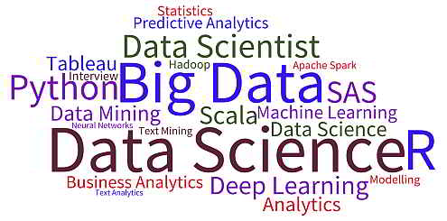
What is AI/ML/NN/DL?
Artificial intelligence
Machine Learning
Neural Networks
Deep Learning

Slide 37
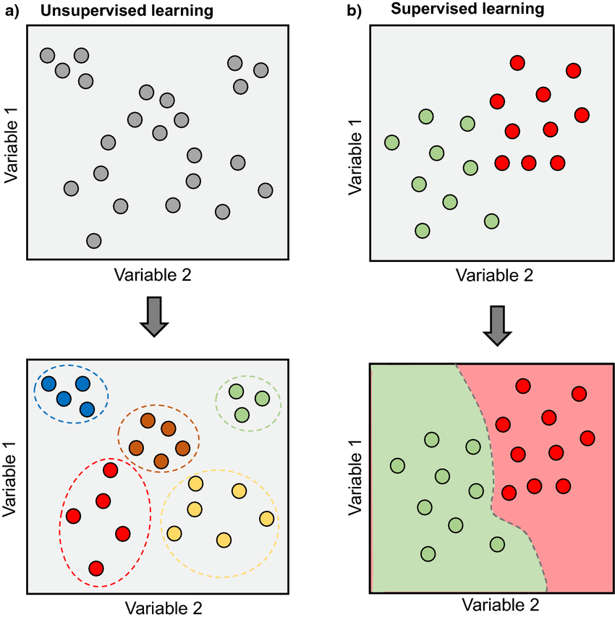
Supervised vs Unsupervised Learning
Definition (Supervised vs. Unsupervised Learning):
Supervised and Unsupervised Learning are the two techniques of ML.
The main difference is the need for labelled training data:
Supervised machine learning relies on labelled input and output data to learn and make predictions,
while unsupervised learning does not require labelled data.

Slide 38
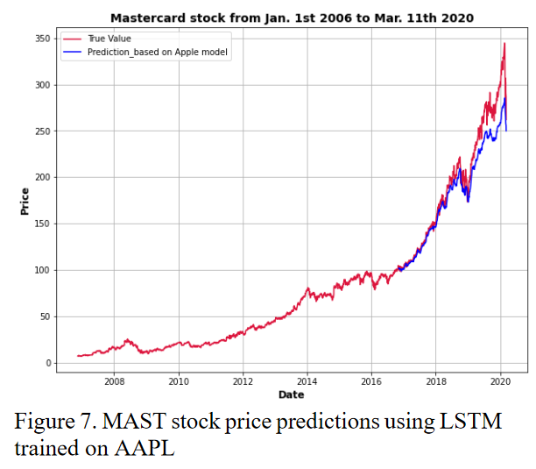

Supervised Learning Examples
Examples of supervised learning: spam detection, text classification, predicting the stock market, etc.

Slide 39
Regression vs. Classification
Definition (Regression):
Regression models are used to identify the relationships between the input and output variables.
Regression algorithms are used to predict continuous values such as price, salary, age, etc.
In regression, the outputs are often continuous numerical values.

Slide 40
Regression vs. Classification (Supervised)
Definition (Classification):
Classification models are used to divide the samples in the dataset into different classes.
Classification algorithms are then used to predict/classify discrete values, such as Male or Female, True or False, Spam or Not Spam, etc.
In Classification, the outputs are discrete or categorical values.

Slide 41
Supervised Learning Examples
Example: predicting the market.
Question: is it a regression or a classification task?

Slide 42
Supervised Learning Examples
Example: predicting the market.
Question: is it a regression or a classification task?
Depends.
If the output we are predicting is the value of the stock in the future, then probably regression.
If the plan is to predict whether we should buy, sell or hold, then probably classification.

Slide 43
Deep Learning and Supervised/Unsupervised
While it is possible to use Deep Learning models and Neural Networks to perform both Supervised and Unsupervised tasks…
The vast majority of DL/NN tasks fall in the category of supervised learning.
(And we will therefore mostly focus on that)

Slide 44
Elements of a ML problem
Definition (Elements of a ML problem):
Machine learning problems should be well-defined, i.e. the following elements must be clearly identified:
Task (T) at hand,
Inputs (I) and Outputs (O),
Model (M) definition and its trainable parameters (P),
Loss (L) function to measure the performance of current model on said task and dataset.

Slide 45
Our first toy example
Our first toy example: simplified version of the apartment price prediction.
Task (T) at hand:
Predict price of an apartment based on the apartment features.
We will generate a “fake” dataset consisting of apartments with features and selling prices.
It is a supervised regression task.

Slide 46
Our first toy example
Our first toy example: simplified version of the apartment price prediction.
Inputs (I) and Outputs (O):
Inputs will be a list of apartment features, which here will only consist of the surface of the apartment, in square meters (sqm).
Output will be the selling price in millions of SGD (mSGD).

Slide 47
Our first toy example (mock dataset)
Have a look at Week 1, Notebook 1.
We will create a dataset, which uses surfaces as inputs, with values drawn randomly between 40 and 150 sqm.
We will assume that the price is randomly generated, using a uniform distribution, with:
Average price being 100000 + 14373 times the surface in sqm,
and a random "variation" of +/- 10% around the average value.

Slide 48
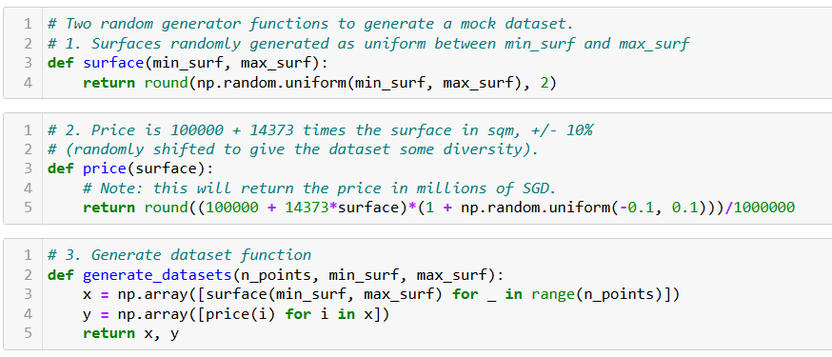
Our first toy example (mock dataset)

Slide 49
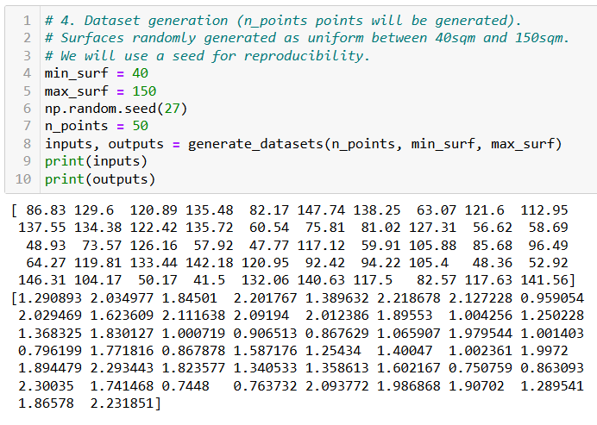
Our first toy example (mock dataset)

Slide 50
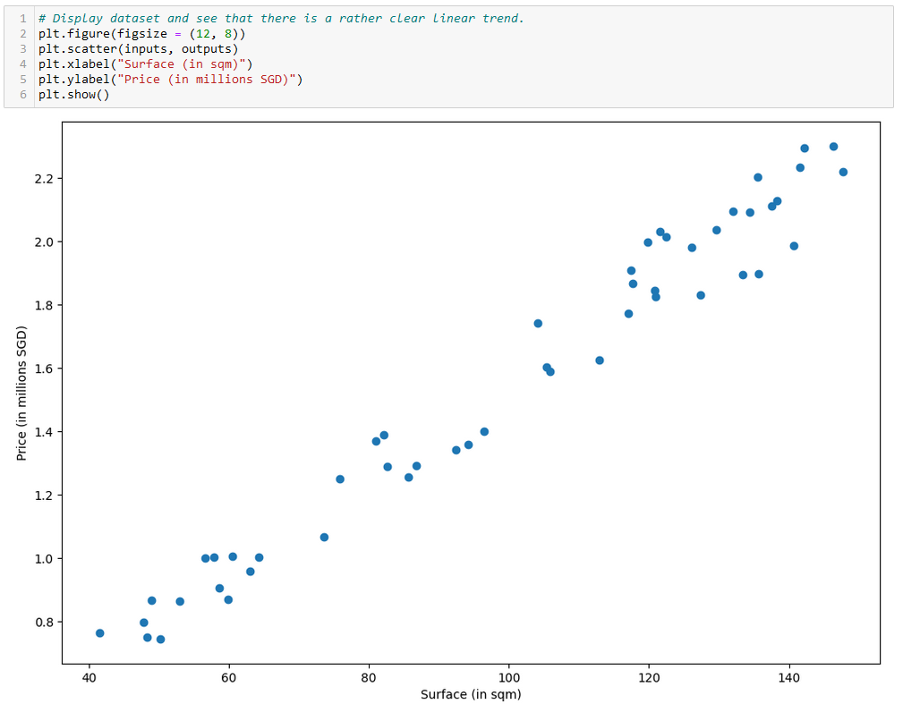

Slide 51
Our first toy example
Our first toy example: simplified version of the apartment price prediction.
Model (M) definition and its trainable parameters (P):
Here, our model will consist of a linear regression model.

Slide 52
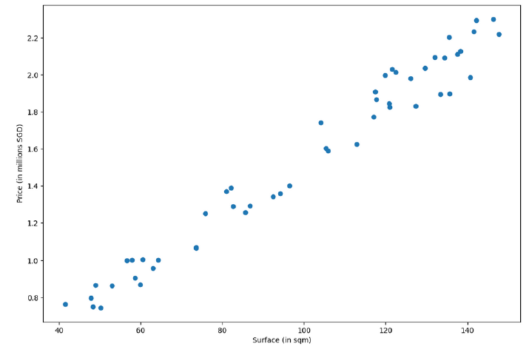
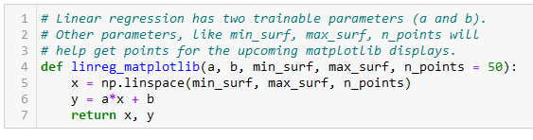
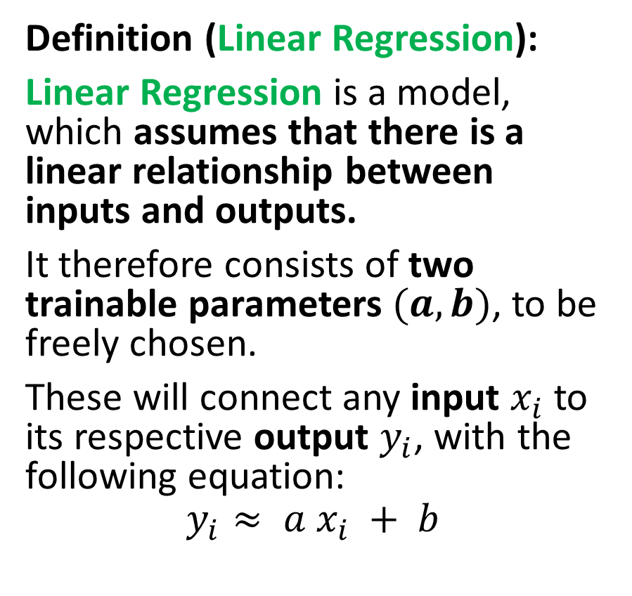
Our first model, the linear regression
Definition (Linear Regression):
Linear Regression is a model, which assumes that there is a linear relationship between inputs and outputs.
It therefore consists of two trainable parameters $(a, b)$, to be freely chosen.
These will connect any input $x_{i}$ to its respective output $y_{i}$, with the following equation:
$$y_{i}≈ a x_{i} + b$$

Slide 53
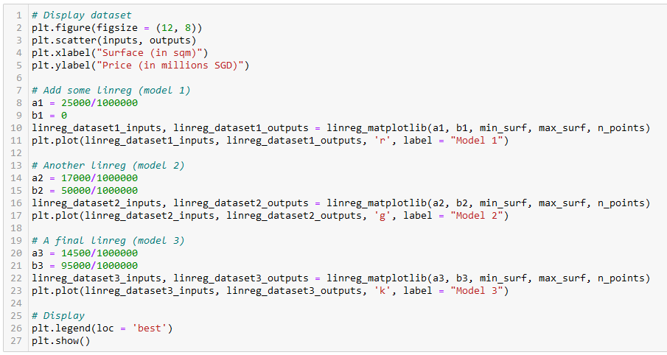
Let us try different values of (a, b)
Model 1 (red)
Model 2
(green)
Model 3
(black)

Slide 54
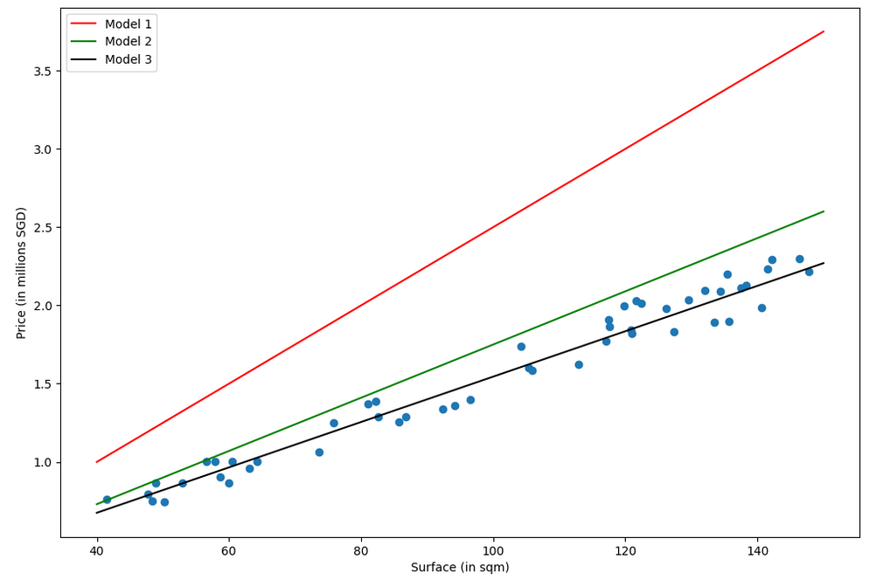
Which model is the best fit for this task in your opinion? (red, green or black?)
Why is one better than another?

Slide 55
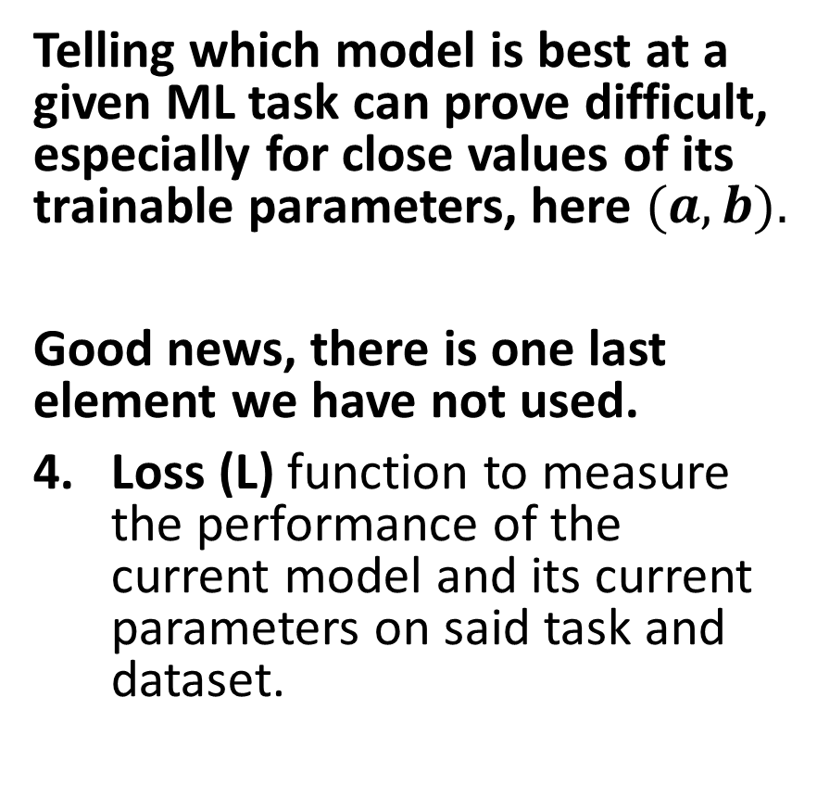
The need for a loss function
Which model is the best fit for this task in your opinion? (red, green or black?)
Why is one better than another?
Telling which model is best at a given ML task can prove difficult, especially for close values of its trainable parameters, here $(a, b).$
Good news, there is one last element we have not used.
Loss (L) function to measure the performance of the current model and its current parameters on said task and dataset.

Slide 56
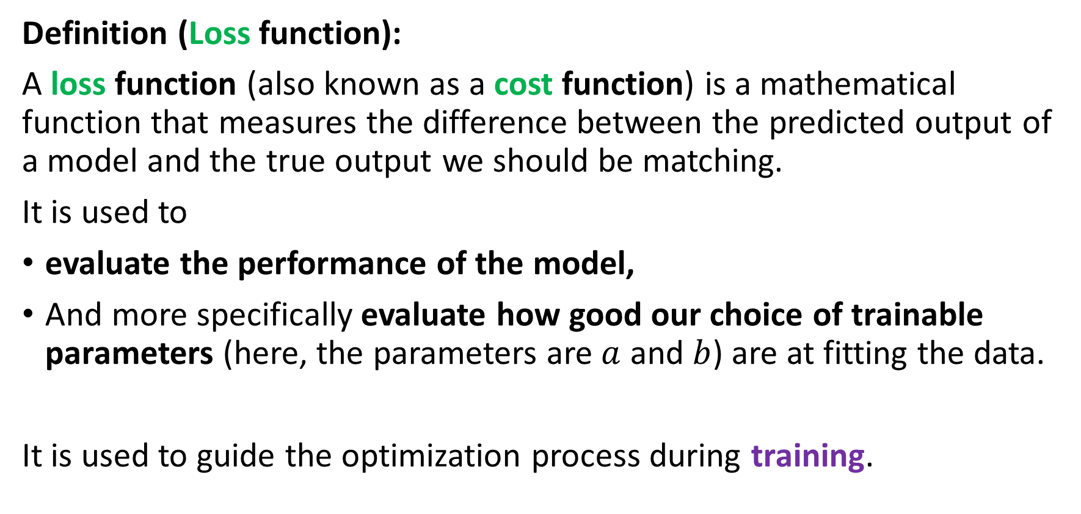
The need for a loss function
Definition (Loss function):
A loss function (also known as a cost function) is a mathematical function that measures the difference between the predicted output of a model and the true output we should be matching.
It is used to
evaluate the performance of the model,
And more specifically evaluate how good our choice of trainable parameters (here, the parameters are $a$ and $b$) are at fitting the data.
It is used to guide the optimization process during training.

Slide 57
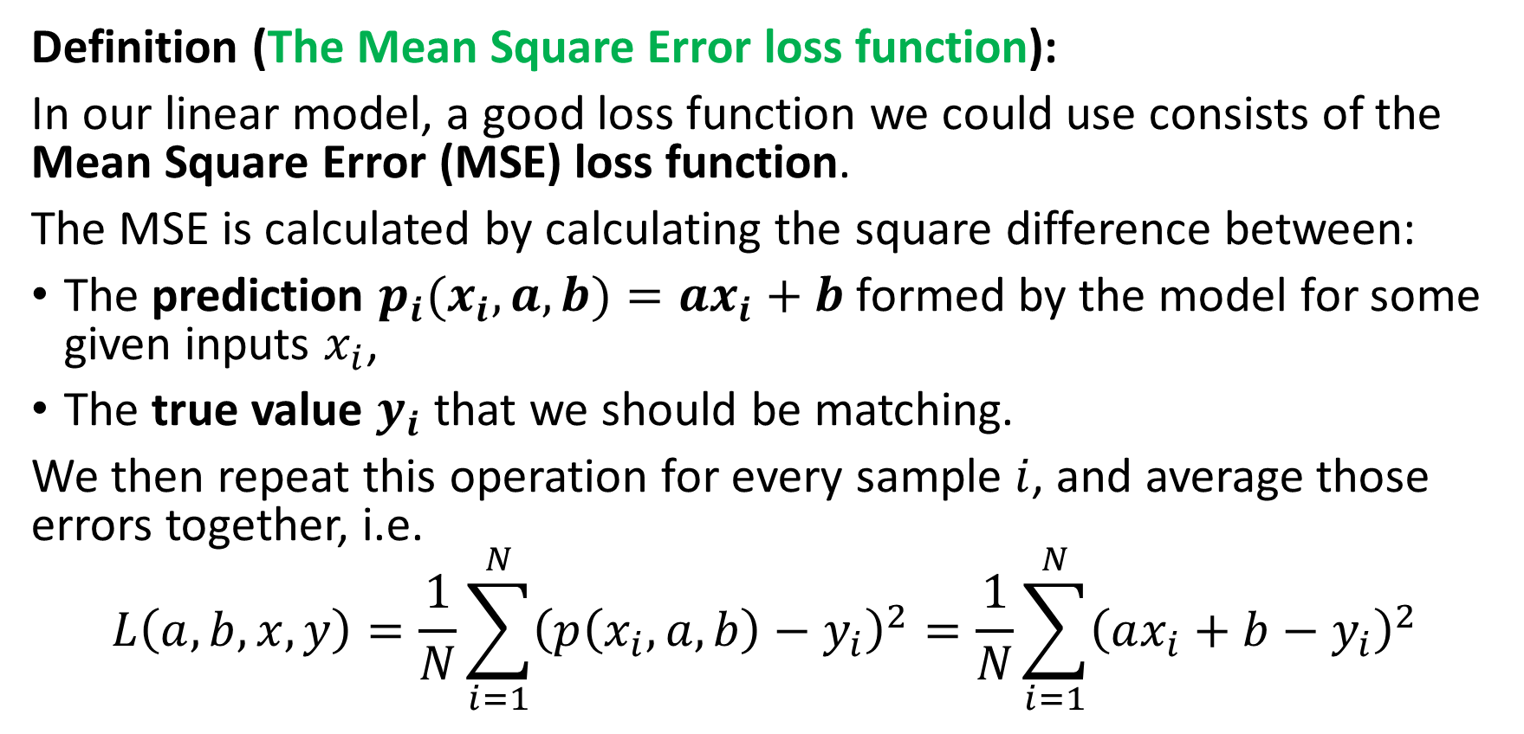
The need for a loss function
Definition (The Mean Square Error loss function):
In our linear model, a good loss function we could use consists of the Mean Square Error (MSE) loss function.
The MSE is calculated by calculating the square difference between:
The prediction $p_{i}(x_{i},a,b)=ax_{i}+b$formed by the model for some given inputs $x_{i}$,
The true value $y_{i}$ that we should be matching.
We then repeat this operation for every sample $i$, and average those errors together, i.e.
$$L\left(a, b,x, y\right)=\frac{1}{N}\sum_{i=1}^{N}{{\left(p\left(x_{i}, a, b\right)−y_{i}\right)}^{2}}=\frac{1}{N}\sum_{i=1}^{N}{{\left(ax_{i}+b−y_{i}\right)}^{2}}$$

Slide 58
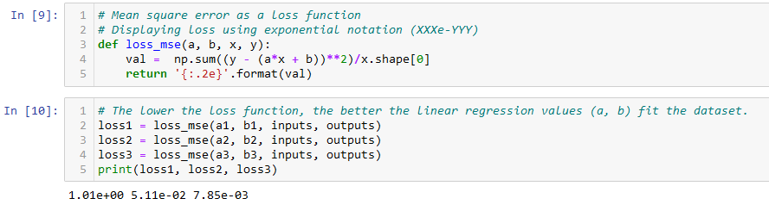
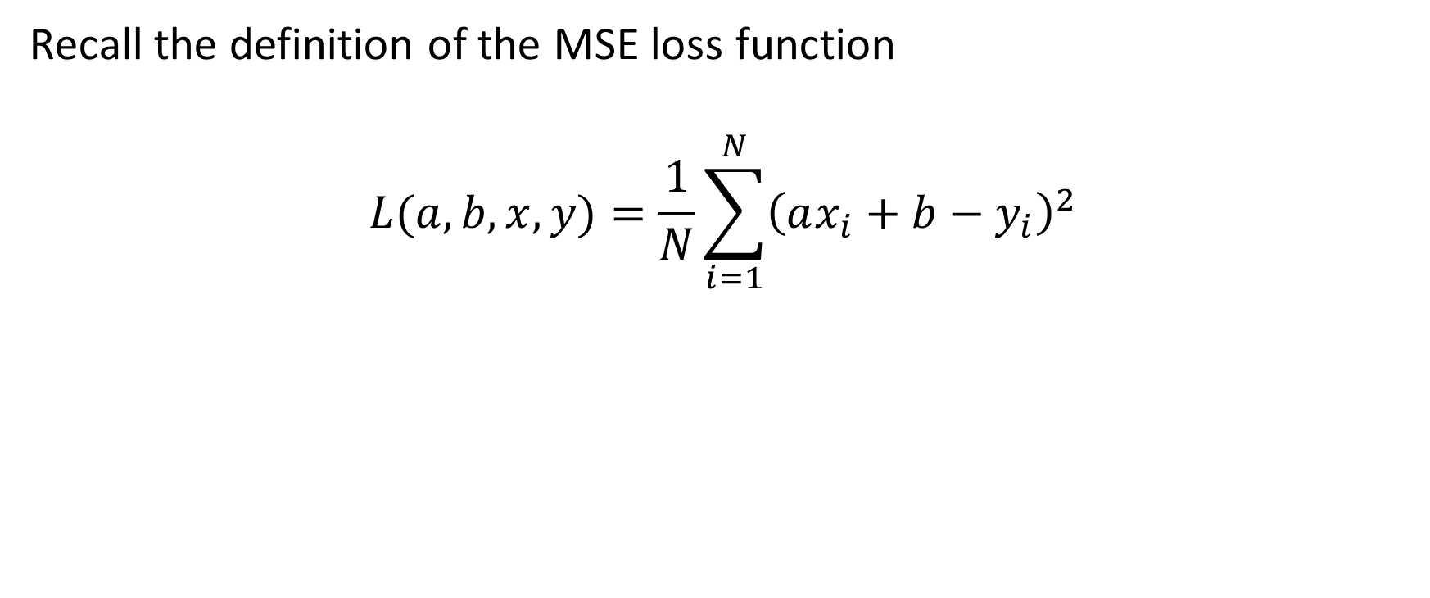
The need for a loss function
Recall the definition of the MSE loss function
$$L(a, b,x, y)=\frac{1}{N}\sum_{i=1}^{N}{{\left(ax_{i}+b−y_{i}\right)}^{2}}$$

Slide 59
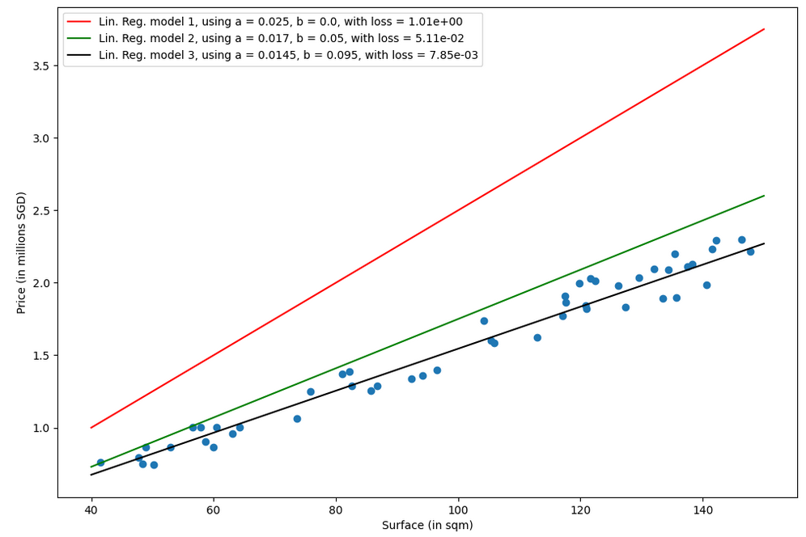
Which model is the best fit for this task in your opinion? (red, green or black?)
Why is one better than another?
Answer: Black model, because it has a lower loss value than the green and red ones!

Slide 60
Training a model
Definition (Training a model):
Training a model consists of finding the best values for the trainable parameters of the chosen model, for the given task and dataset.
By best values for the trainable parameters, we mean the values that minimize the chosen loss function. It is therefore an optimization problem of some sort!
Once a minimal value is obtained on the loss function, then we can claim that the “optimal” trainable parameters have been found.
Or in other words, that the model has been trained.

Slide 61
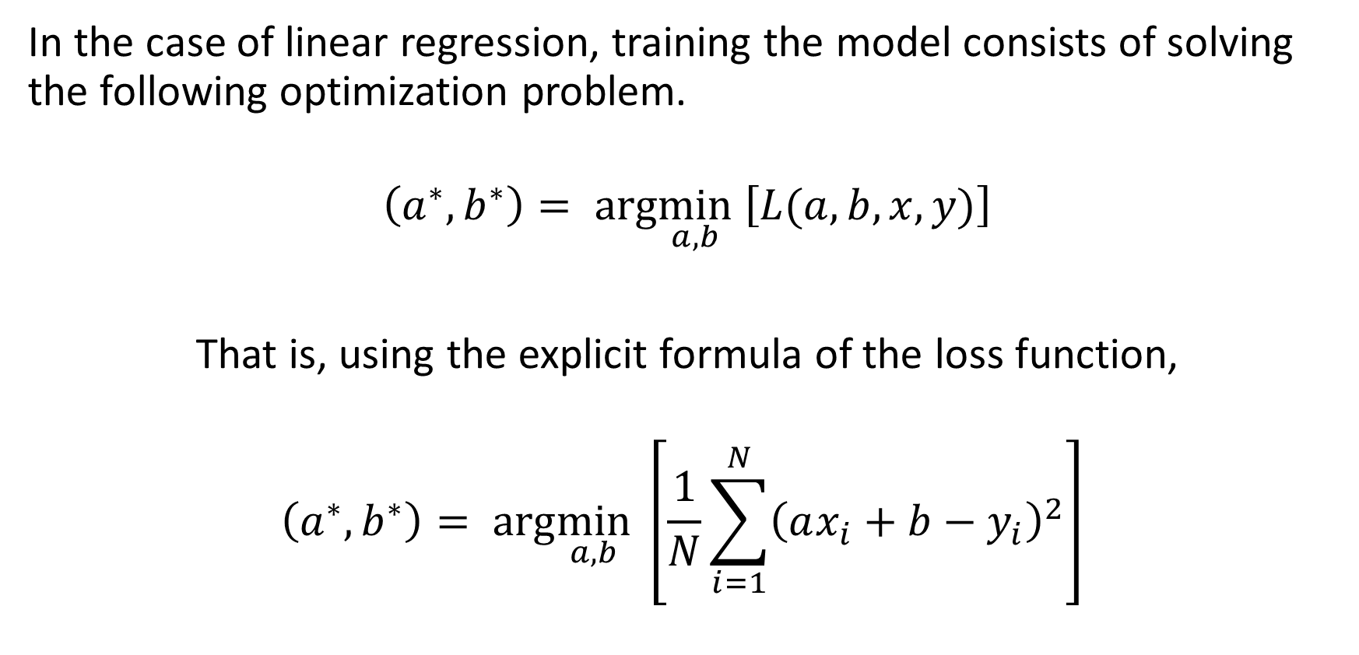
Training a linear regression model
In the case of linear regression, training the model consists of solving the following optimization problem.
$$\left(a^{∗},b^{∗}\right)= arg\min_{a,b} \left[L(a, b,x, y)\right]$$
That is, using the explicit formula of the loss function,
$$\left(a^{∗},b^{∗}\right)= arg\min_{a,b} \left[\frac{1}{N}\sum_{i=1}^{N}{{\left(ax_{i}+b−y_{i}\right)}^{2}}\right]$$

Slide 62
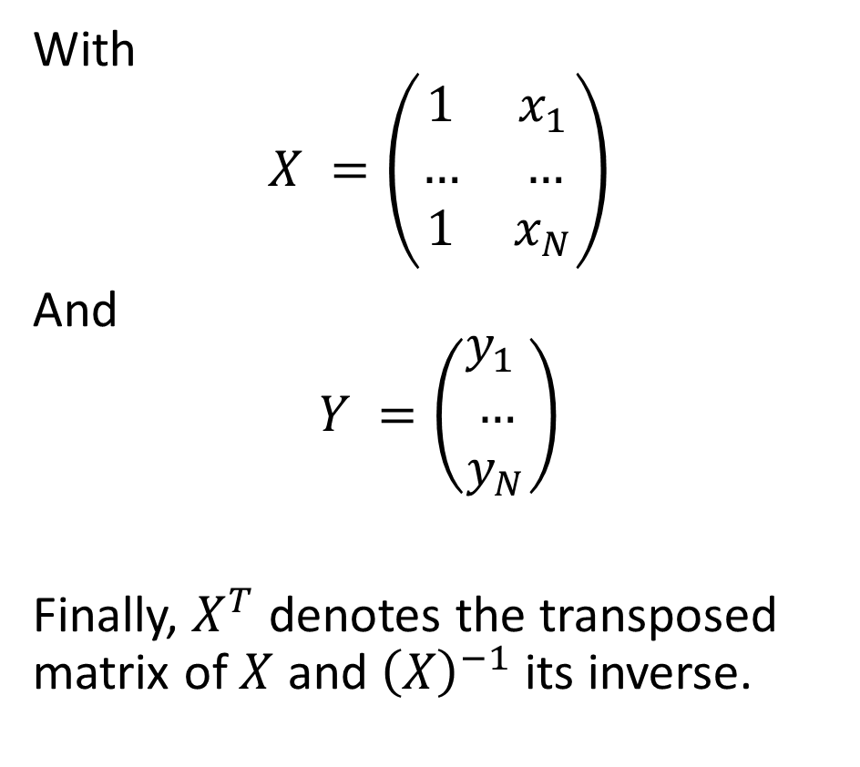
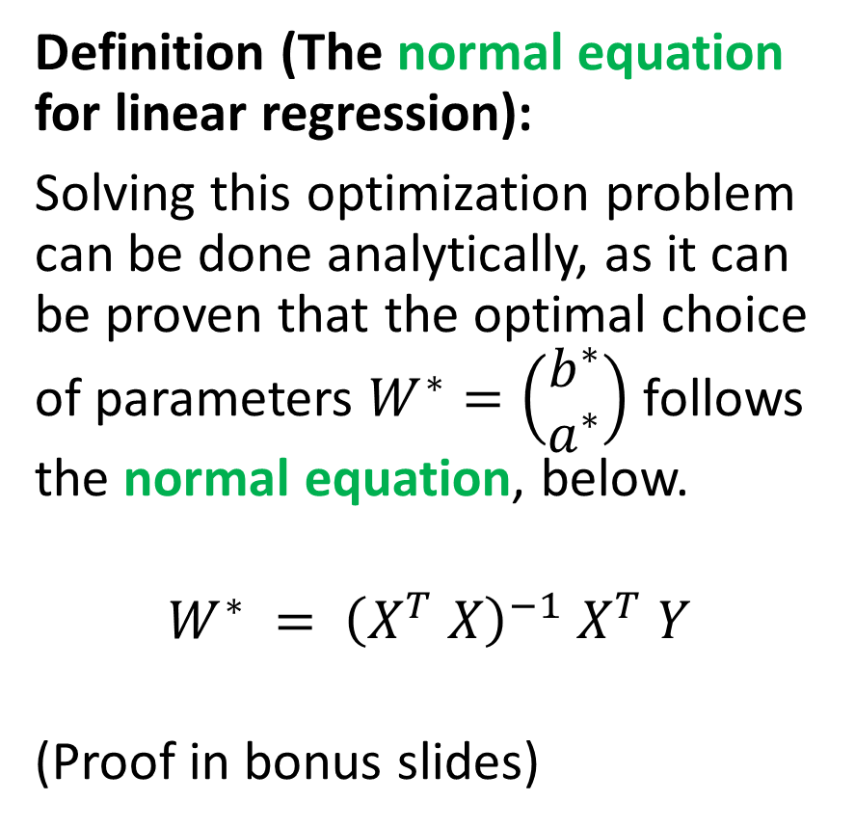
Training a linear regression model
Definition (The normal equation for linear regression):
Solving this optimization problem can be done analytically, as it can be proven that the optimal choice of parameters $W^{∗}=\left(\begin{matrix}b^{∗} \\ a^{∗}\end{matrix}\right)$ follows the normal equation, below.
$$W^{∗} = {\left(X^{T} X\right)}^{−1} X^{T} Y$$
(Proof in bonus slides)
With
$$X =\left(\begin{matrix}1 & x_{1} \\ … & … \\ 1 & x_{N}\end{matrix}\right)$$
And
$$Y =\left(\begin{matrix}y_{1} \\ … \\ y_{N}\end{matrix}\right)$$
Finally, $X^{T}$ denotes the transposed matrix of $X$ and ${\left(X\right)}^{−1}$its inverse.

Slide 63
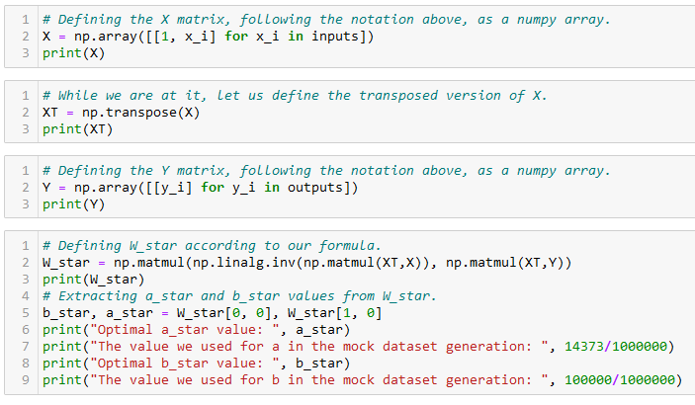
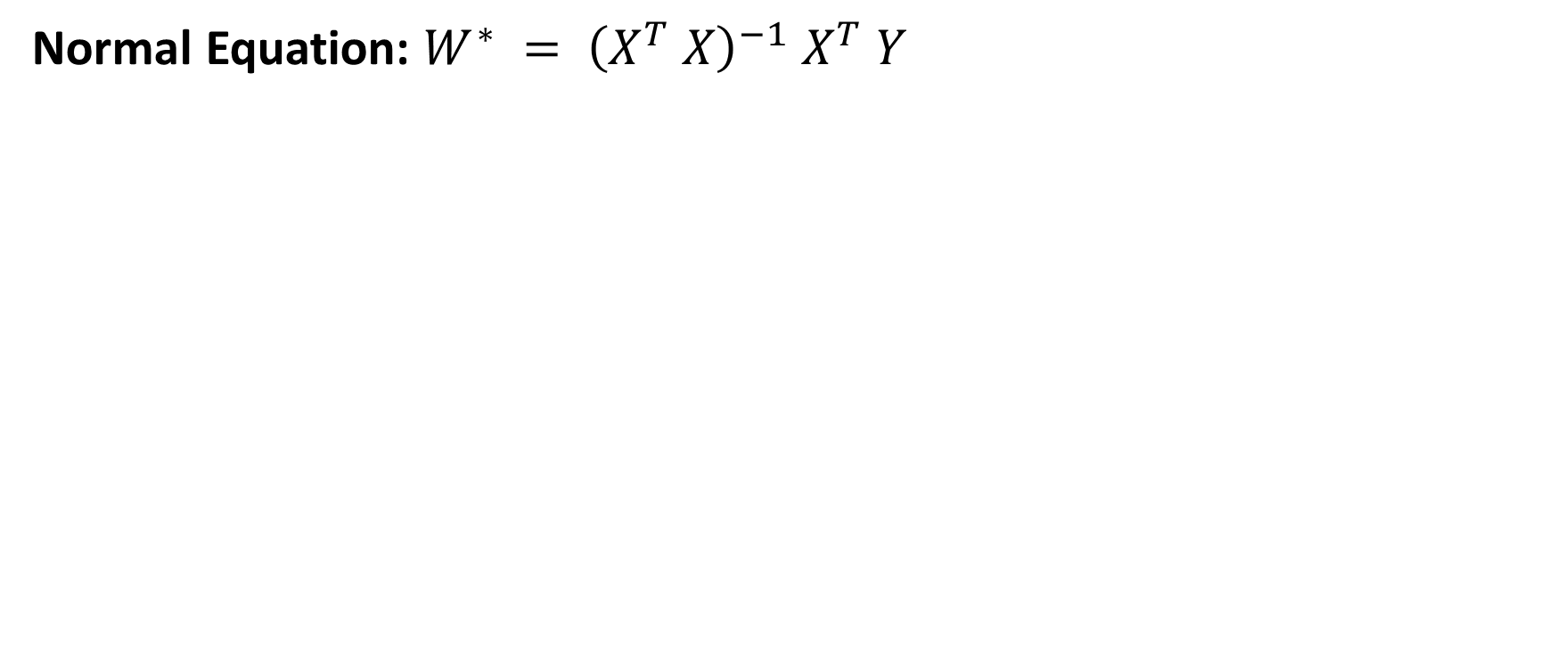
Training a linear regression model
Normal Equation: $W^{∗} = {\left(X^{T} X\right)}^{−1} X^{T} Y$

Slide 64
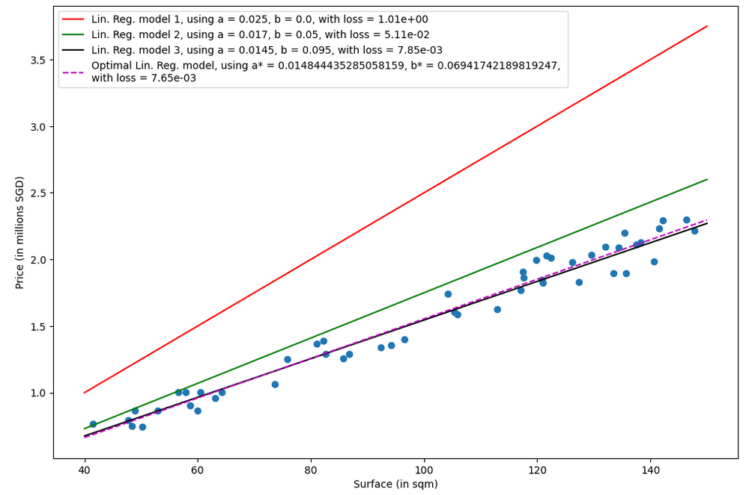
Purple line is the optimal set of parameters for our model on the given task and dataset!
Black was pretty close!

Slide 65
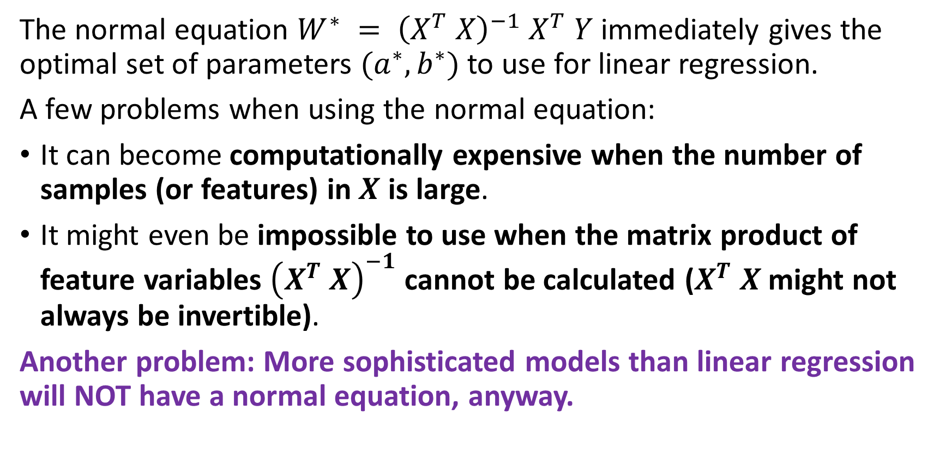
The problem with the normal equation
The normal equation $W^{∗} = {\left(X^{T} X\right)}^{−1} X^{T} Y$immediately gives the optimal set of parameters $(a^{∗}, b^{∗})$to use for linear regression.
A few problems when using the normal equation:
It can become computationally expensive when the number of samples (or features) in $X$ is large.
It might even be impossible to use when the matrix product of feature variables ${\left(X^{T} X\right)}^{−1}$ cannot be calculated ($X^{T} X$might not always be invertible).
Another problem: More sophisticated models than linear regression will NOT have a normal equation, anyway.

Slide 66
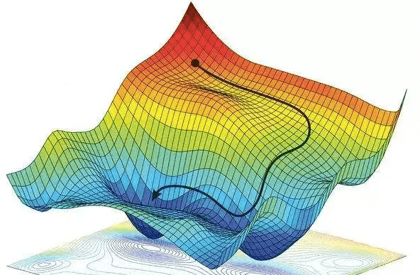
Gradient Descent, to the rescue!
Definition (Gradient Descent):
Gradient Descent (GD) is an iterative algorithm used to solve optimization problems.
It starts with an initial non-optimal set of parameters for our model.
It then repeatedly updates the parameters in the direction of the negative gradient of the given cost function, until it converges to a local minimum.
Forgot about GD? Have a look at your notes from 10.013 M&A!

Slide 67
Gradient Descent, to the rescue!
Definition (Gradient Descent):
Gradient Descent (GD) is an iterative algorithm used to solve optimization problems.
It starts with an initial non-optimal set of parameters for our model.
It then repeatedly updates the parameters in the direction of the negative gradient of the given cost function, until it converges to a local minimum.
The normal equation has many problems…
But GD, on the other hand can be used to find the optimal solution even when the normal equation is not applicable.
While sub-optimal, the main advantage of gradient descent is that it can handle very large datasets and it can also be used for non-linear models.

Slide 68
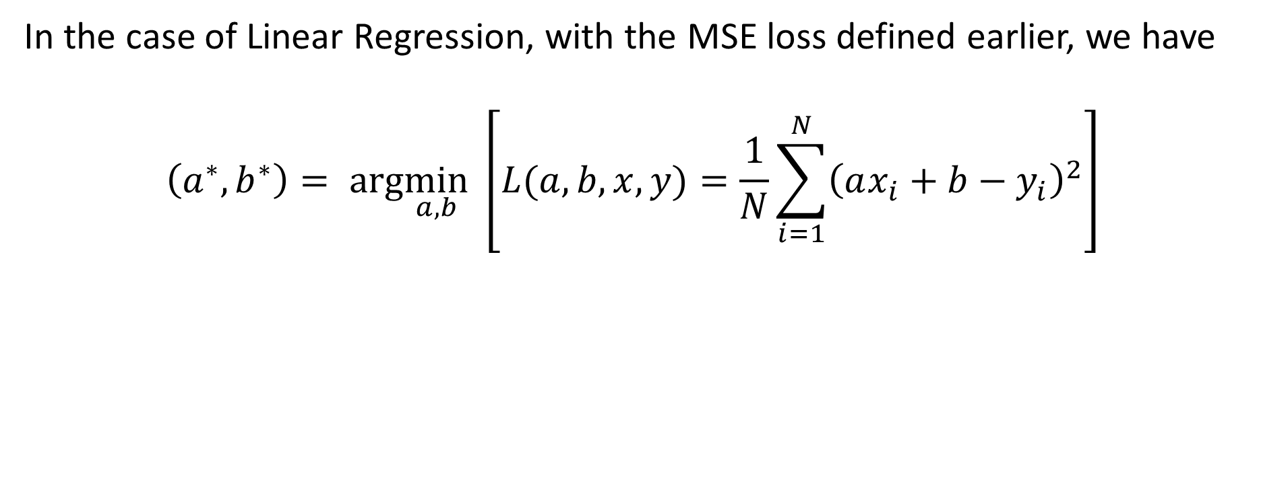
GD in Linear Regression
In the case of Linear Regression, with the MSE loss defined earlier, we have
$$\left(a^{∗},b^{∗}\right)= arg\min_{a,b} \left[L(a, b,x, y)=\frac{1}{N}\sum_{i=1}^{N}{{\left(ax_{i}+b−y_{i}\right)}^{2}}\right]$$

Slide 69
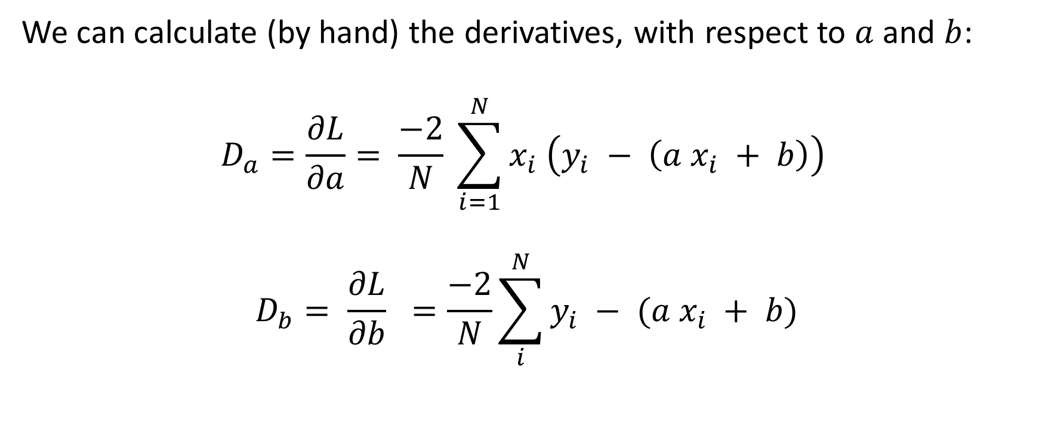
GD in Linear Regression
We can calculate (by hand) the derivatives, with respect to $a$ and $b$:
$$D_{a}=\frac{∂L}{∂a}= \frac{−2}{N} \sum_{i=1}^{N}{x_{i} \left(y_{i} − \left(a x_{i} + b\right)\right)}$$
$$D_{b}= \frac{∂L}{∂b} =\frac{−2}{N}\sum_{i}^{N}{y_{i} − (a x_{i} + b)}$$

Slide 70
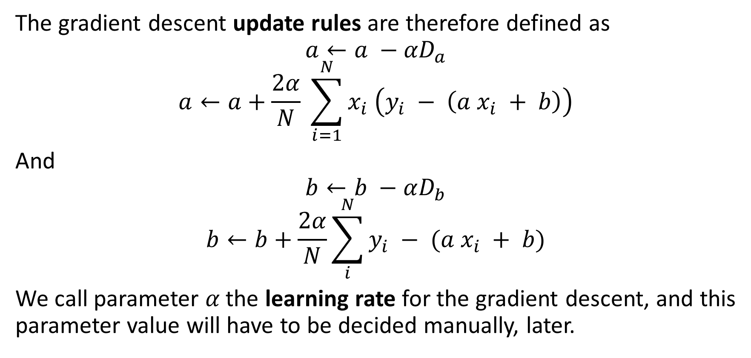
GD in Linear Regression
The gradient descent update rules are therefore defined as
$$a←a −{αD}_{a}$$
$$a←a+\frac{2α}{N} \sum_{i=1}^{N}{x_{i} \left(y_{i} − \left(a x_{i} + b\right)\right)}$$
And
$$b←b −αD_{b}$$
$$b←b+\frac{2α}{N}\sum_{i}^{N}{y_{i} − (a x_{i} + b)}$$
We call parameter 𝛼 the learning rate for the gradient descent, and this parameter value will have to be decided manually, later.

Slide 71
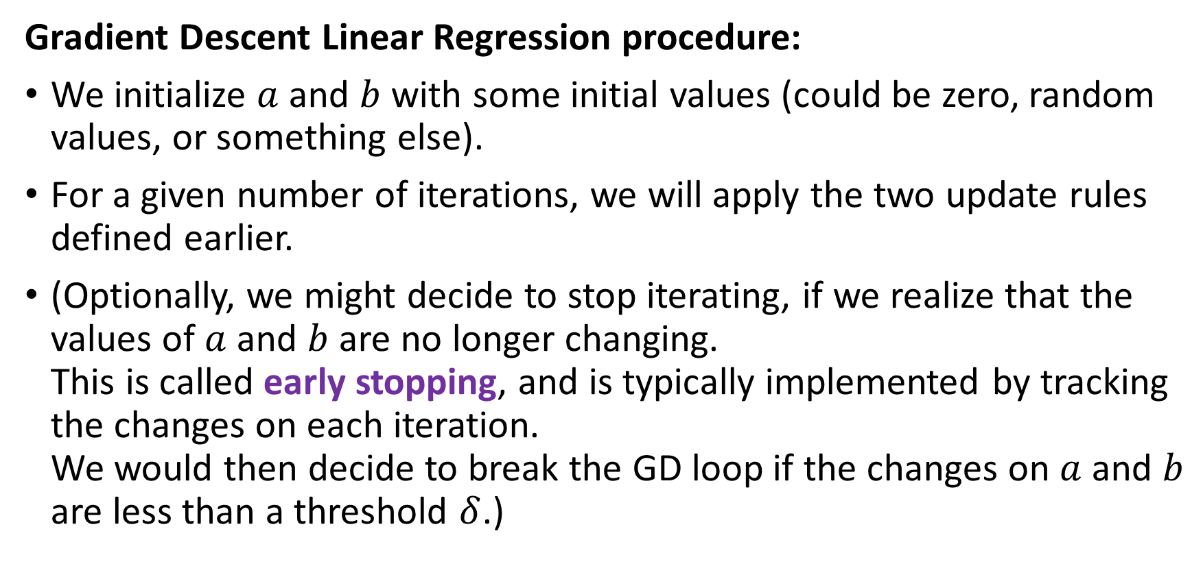
GD in Linear Regression
Gradient Descent Linear Regression procedure:
We initialize $a$ and $b$ with some initial values (could be zero, random values, or something else).
For a given number of iterations, we will apply the two update rules defined earlier.
(Optionally, we might decide to stop iterating, if we realize that the values of $a$ and $b$ are no longer changing. This is called early stopping, and is typically implemented by tracking the changes on each iteration. We would then decide to break the GD loop if the changes on $a$ and $b$ are less than a threshold $δ$.)

Slide 72
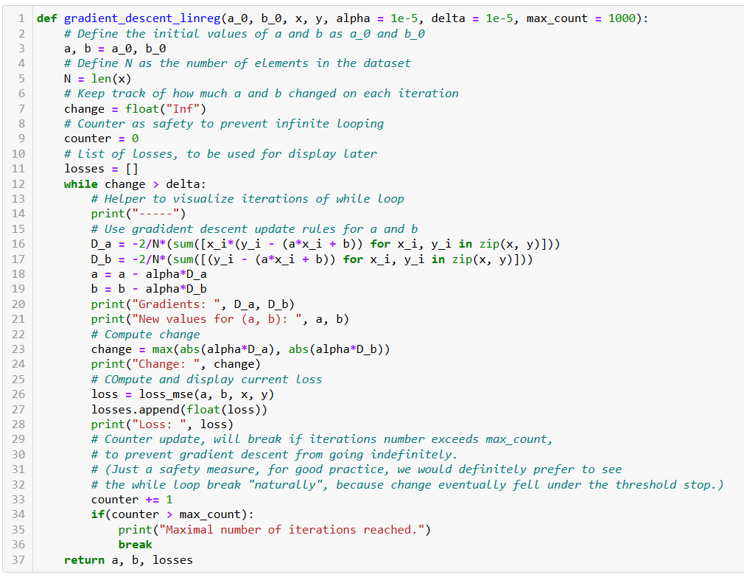
Initialize a and b as you please.

Slide 73
Number of samples in dataset.

Slide 74
Two possible stopping conditions, change < delta or counter > max_count.

Slide 75
Update using our GD update rules from earlier.

Slide 76
Compute change on this iteration (to decide on early stopping if changes become insignificant).

Slide 77
Calculate new MSE value using the new parameters of a and b. We also keep track of these losses by adding them to a list, used for display later.

Slide 78
Return trained parameters and losses evolution on each iteration.

Slide 79
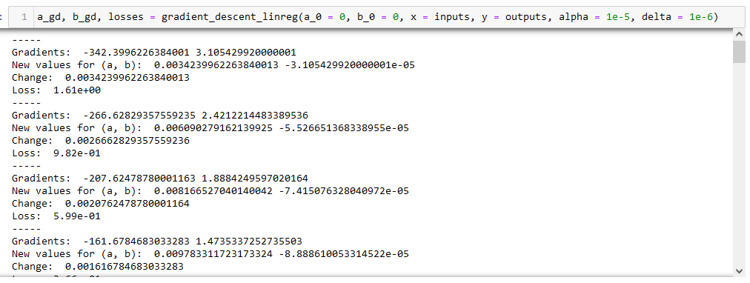
Observation: Loss is decreasing over iterations (which is good news for us!)

Slide 80
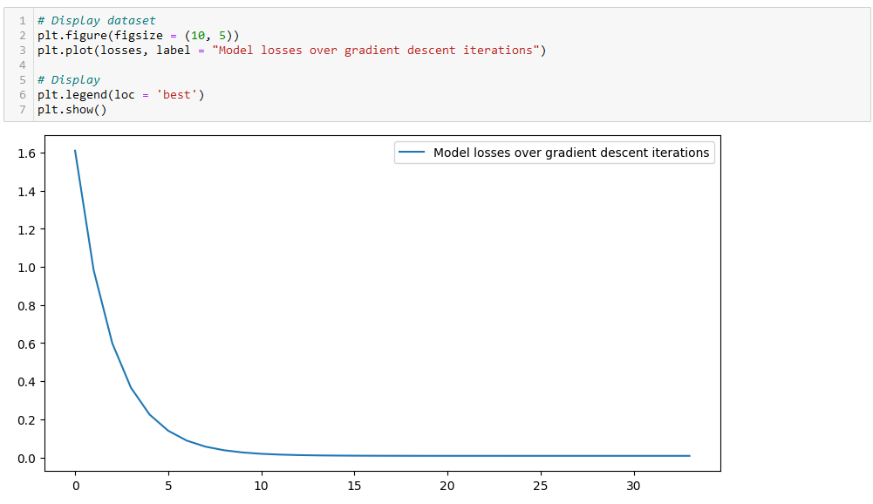
Observation: Confirmed with a plot. Loss is decreasing over iterations (which is good news for us!)
Even seems to converge to a minimum value, corresponding to the optimal set of trainable parameters?

Slide 81
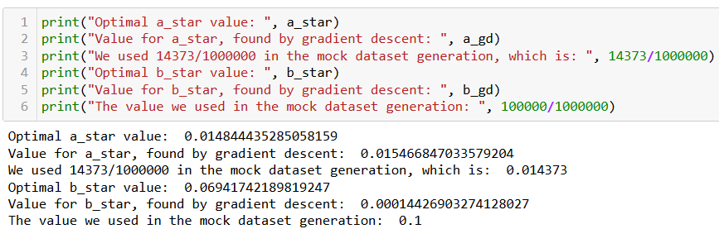
Checking for optimal parameters
We have generated the dataset ourselves, so we know the optimal values for a and b!

Slide 82
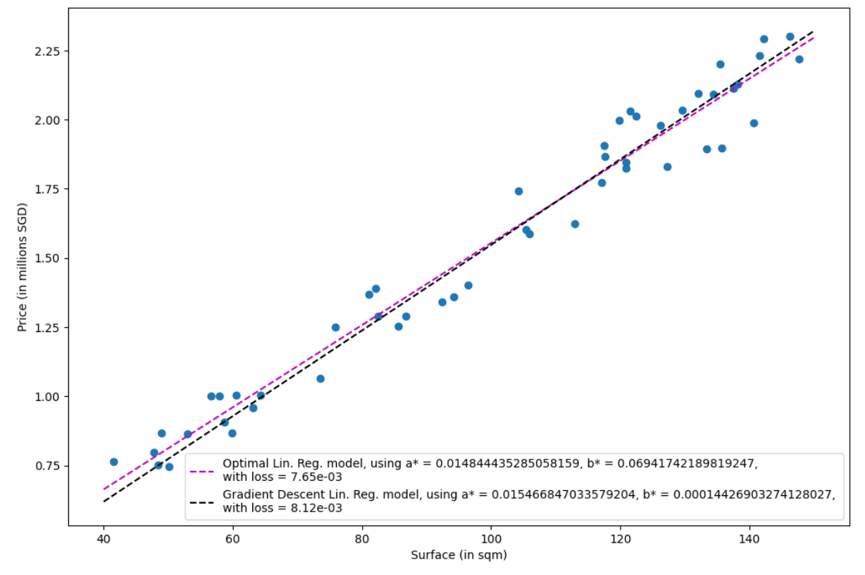
Observation: Close match, good enough for us. (Not perfect due to randomness in the dataset generation!)

Slide 83
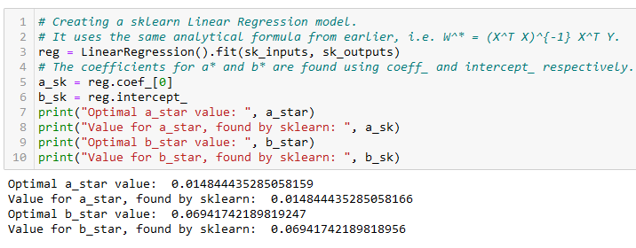
Using Sklearn for Linear regression
In practice, we never implement the linear regression model ourselves (but it is a good practice to try it at least once!)
It is often better/faster to rely on the sklearn library and use the LinearRegression object!

Slide 84
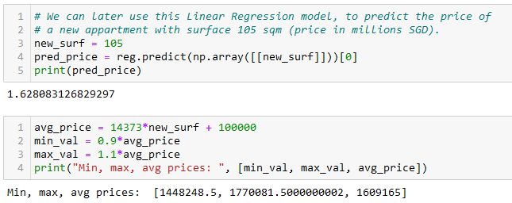
Predicting using Sklearn Linear regression
After training, it is also good practice to check if the predictor makes sense, by testing it and asking it to predict the price of an apartment it has never seen before.
Confirm the pertinence of predicted values manually, if possible.

Slide 85
More specifically
Specific topics in linear algebra to focus on:
Vectors, dot product, norms of vectors
Matrices and their properties: determinant, rank, norm, trace, transpose
Matrix multiplication and inversion
Solving systems of linear equations
Eigenvectors and eigenvalues
Projections and orthonormality
(Symmetric matrices, positive semi-definite matrices)
(Matrix decompositions, e.g. LU decomposition, SVD)

Slide 86
More specifically
Specific topics in calculus to focus on:
Logarithmic and exponential functions
Derivatives and partial derivatives, the chain rule of derivatives
(Integrals basics)
Multivariate calculus: functions of vectors and matrices and their gradients.
(Jacobian and Hessian)
Equations of lines and hyperplanes
Solving optimization problems with Gradient Descent, Lagrange multipliers, and other methods.

Slide 87
More specifically
Specific topics in probabilities and statistics to focus on:
Probability rules and axioms, random variables (both discrete and continuous)
Standard distributions (Bernoulli, Binomial, Multinomial, Uniform and Gaussian)
Expectation, variance, covariance and correlation
Conditional probability, Bayes’ theorem
(Law of total probability)
(Joint and marginal probability distributions)
The central limit theorem

Slide 88
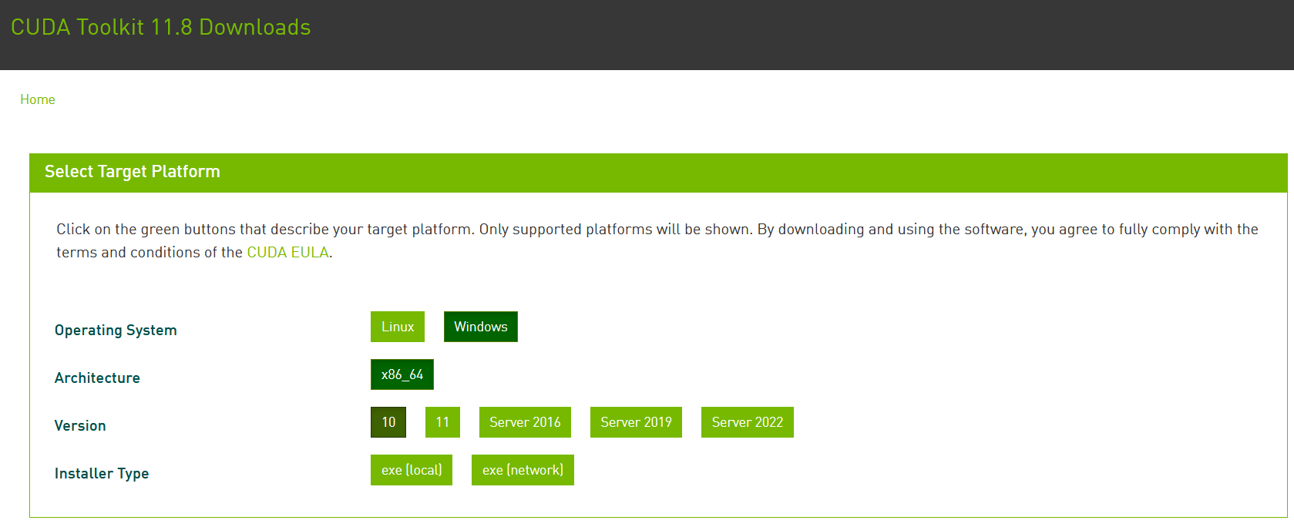
Installing PyTorch and CUDA
Check if your GPU is in the list of acceptable GPUs. https://developer.nvidia.com/cuda-gpus
If so, install CUDA (check that you CUDA version number matches the one of your PyTorch install!) https://developer.nvidia.com/cuda-downloads

Slide 89
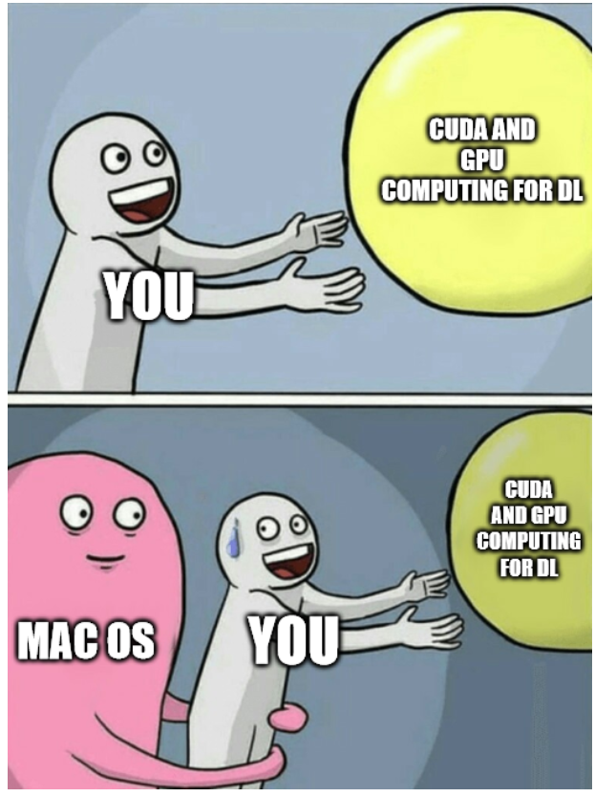
Installing PyTorch and CUDA
Question: How to use CUDA with MacOS?
Efforts are being made to make GPU computing compatible with AMD and MacOS GPUs, but not the best (afaik).

Slide 90
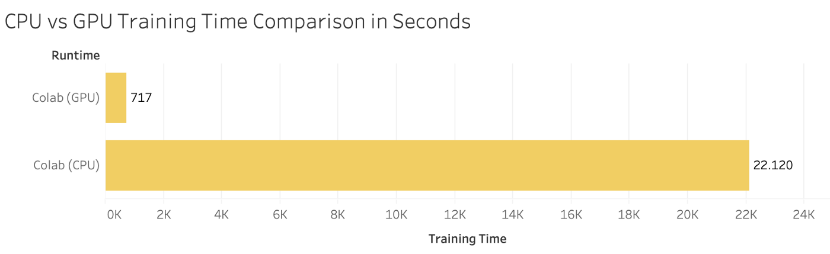

Installing PyTorch and CUDA
Your GPU not in the list of CUDA-enabled GPUs?
You bought a MacOS laptop?
Most notebooks can still run on CPU (but they might take significantly longer to run).
Also, always the option of using Google Colab, or create an education account on AWS.

Slide 91
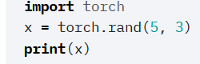


Checking your PyTorch and CUDA install
Hello World for PyTorch: to check you have PyTorch installed correctly. The code below should run and display a tensor.
Hello World for CUDA: to check you have correctly installed CUDA on top of PyTorch. The code below should print True, as the output of torch.cuda.is_available()

Slide 92

A quick word about PyTorch 2.0
PyTorch v2.0 is the current (latest version released in March 2023).
Should be fully retro-compatible.
Revising and testing notebooks (they were designed last year and tested on v1.13).
Kindly let me know if you have any issues!
Will let you know about new v2.0 features on W13.

Slide 93
Supervised vs Unsupervised Learning
Definition (Supervised vs. Unsupervised Learning):
Supervised and Unsupervised Learning are the two techniques of ML.
The main difference is the need for labelled training data:
Supervised machine learning relies on labelled input and output data to learn and make predictions,
while unsupervised learning does not require labelled data.

Slide 94

Unsupervised Learning Examples
Examples of unsupervised learning: clustering customers based on their behaviours, segmenting images, and identifying topics in a document.

Slide 95


Unsupervised Learning Examples
Identify topics that seem to appear in those papers and their prominence
Examples of unsupervised learning: clustering customers based on their behaviors, segmenting images, and identifying topics in a document.

Slide 96
Clustering vs. Association (Unsupervised)
Definition (Clustering vs. Association):
Unsupervised learning can be used for two types of problems: Clustering and Association.
The main difference is that
clustering groups data based on similarity,
while association looks for relationships between variables.

Slide 97
Clustering vs. Association (Unsupervised)
Examples of clustering:
Group customers into clusters based on the similarities in their purchasing behaviours, such as their spending habits or types of products they like.
Group the catalogue of movies available on Netflix and identify what movies have in common, so you can later recommend a movie to a user based on what he/she has seen before.

Slide 98




Clustering vs. Association (Unsupervised)
Example of association:
Finding the relationship between customer buying behaviors and customer satisfaction.
Association can be used to understand how changes in customer behavior impacts customer satisfaction, such as if buying a certain product increases customer satisfaction (or the opposite).

Slide 99


Proof of the Normal Equation
Using the notations
$$X =\left(\begin{matrix}1 & x_{1} \\ … & … \\ 1 & x_{N}\end{matrix}\right),$$
$$Y =\left(\begin{matrix}y_{1} \\ … \\ y_{N}\end{matrix}\right),$$
$$W^{∗}=\left(\begin{matrix}b^{∗} \\ a^{∗}\end{matrix}\right)$$
We have, in matrix form
$$XW^{∗}=\left(\begin{matrix}a^{∗}x_{1}+b^{∗} \\ … \\ a^{∗}x_{N}+b^{∗}\end{matrix}\right)$$
And, then it follows that
$$XW^{∗}−Y=\left(\begin{matrix}a^{∗}x_{1}+b^{∗} −y_{1} \\ … \\ a^{∗}x_{N}+b^{∗}−y_{N}\end{matrix}\right)$$

Slide 100

Proof of the Normal Equation
Our loss function, the MSE $L$, is therefore defined, in matrix format as:
$$L=\frac{1}{N}{\left(XW^{∗}−Y\right)}^{T}\left(XW^{∗}−Y\right)$$
This is equivalent to
$$L=\frac{1}{N}\left({\left(XW^{∗}\right)}^{T}−Y^{T}\right)\left(XW^{∗}−Y\right)$$

Slide 101

Proof of the Normal Equation
We then get
$$L=\frac{1}{N}\left({W^{∗}}^{T}X^{T}−Y^{T}\right)\left(XW^{∗}−Y\right)$$
Expanding
$$L=\frac{1}{N}({W^{∗}}^{T}X^{T}XW^{∗}−Y^{T}XW^{∗}− {W^{∗}}^{T}X^{T}Y+Y^{T}Y)$$

Slide 102

Proof of the Normal Equation
Recall that we are trying to find the solution to optimization problem
$$\left(a^{∗},b^{∗}\right)=arg\min_{a,b}\left[L(a, b,x, y)\right]$$
With
$$L=\frac{1}{N}({W^{∗}}^{T}X^{T}XW^{∗}−Y^{T}XW^{∗}−{W^{∗}}^{T}X^{T}Y+Y^{T}Y)$$
Recognizing that $Y^{T}XW^{∗}={W^{∗}}^{T}X^{T}Y$, differentiating our function $L$with respect to $W$ and equating it to zero gives:
$$\frac{∂L}{∂W}=\frac{1}{N}\left({2X}^{T}XW−2X^{T}Y\right)=0$$

Slide 103

Proof of the Normal Equation
This is equivalent to
$$\left(X^{T}XW^{∗}−X^{T}Y\right)=0$$
Or,
$$X^{T}XW^{∗}=X^{T}Y$$
Assuming $X^{T}X$ is invertible (and that might not always be the case based on your dataset!), this finally gives:
$$W^{∗}={\left(X^{T}X\right)}^{−1}X^{T}Y$$

